Slide 1
Best Practices in Shared Housing
Phil Allen- He/Him- TAC- HUD Technical Assistance
Tuesday, December 6th 3pm-4pm
Pallen@tacinc.org

Slide 2
What is Shared Housing?
Two or more people who live in one permanent rental housing unit and share housing costs
  Home Sharing: Homeowner rents room in exchange for monetary compensation or assistance with household tasks
  Roommate Matching: Housing provider or group of tenants rents
  out entire space to group of people who choose to live together
Shared Housing is NOT:
  the same as doubled-up
  a group home/“facility”
  a standard, fidelity model- not a program, but an approach

Slide 3
Why Shared Housing?
Normal
Decreased living expenses/housing cost burden
Increased access to a larger, more diverse, housing market
Expands the types of neighborhoods people can live in
Shared responsibilities and socialization

Slide 4
Shared Housing in CoC and ESG-funded Programs
Each individual/household must have a standard lease or rental agreement that provides full rights of tenancy.
  FMR (for ESG) or Rent Reasonable (for CoC) for unit size
  Each tenant should have own security deposit
Housing unit must meet your program’s and community’s habitability and/or housing quality standards.
  Must include access to a bathroom and have facilities for cooking and food storage.
  Bedrooms can be used by a single resident or shared with another unrelated individual (check with Field Office regarding need for waiver)

Slide 5
Roommate Matching
Again…always a participant’s choice!
Preparation with each party
  Clarify responsibilities in advance
What is the “right” match
  Facilitated introductions/Meet and Greets/Home Visits
  Questionnaires: traits, preferences, pet peeves, dealbreakers
  Who are people already living with or have lived with in the past?

Slide 6
Roommate Matching Principles
Person-centered process: Housing Navigator gets to know home seeker’s preferences and areas where can compromise
Client choice: Ability to choose to enter into or leave shared housing arrangement
Maintain existing relationships - between clients who then become
roommates, building on existing peer networks when possible
Take Time: Don’t rush to match or match just based on vacancies, comprehensive screening process takes time

Slide 7
Roommate Matching Matrix
What to Look for or Avoid | Very Important | Important | Somewhat Important | Not Important
Someone I like
Someone who will not have many visitors
Someone who smokes
Someone who is clean and sober
Someone with pets
A “night” person
Creating a matching matrix can be a helpful tool for matching roommates.
Some communities have investing is software similar to what colleges and universities use to match roommates.

Slide 8
Community Examples
https://www.va.gov/HOMELESS/ssvf/docs/Shared_Housing_General_Roommate_Matching_Form.pdf
https://www.va.gov/HOMELESS/ssvf/docs/Shared_Housing_FP_Roommate_Interest_Form.pdf

Slide 9
Roommate Agreements
Formalized between roommates to clearly stipulate roles and responsibilities, identify processes and provide accountability for conflict mediation
Not a requirement- may not need to do, but helpful to start and conversation and have as a resource
Ensure that staff are well-versed in conflict mediation strategies to assist when needed.

Slide 10
Roommate Agreements should include the following components (DeJong & Freed, 2017):
Emergency contact numbers for the
intermediary organization
Conflict mediation processes
Responsibility for damages
Responsibility for household supplies
(cleaning products, garbage bags, light bulbs, dish/laundry detergents, etc.)
Kitchen use time limitations
Food storage space and use
Definition of private and common spaces and use limitations
Definition of shared and private items
(pots and pans, dishes, etc.) and use limitations
Bathroom use and limitations
Privacy and guest rules, including
overnight guests
House rules: smoking, alcohol, pets, noise and quiet times
Roles and responsibilities for chores, cleaning, dishes, garbage
Specifics (frequency, duration) of
service exchange if applicable
Any other deal breakers of either party

Slide 11
Community Examples
https://www.va.gov/HOMELESS/ssvf/docs/Shared_Housing_Path_Roommate_Agreement.pdf
https://endhomelessness.org/resource/rapid-re-housing-toolkit/1-22-shared-housing-agreement/
https://www.sharedhousinginstitute.com/docs

Slide 12
Landlord/Leasing Issues
Messaging and Landlord Engagement:
  Goal: Identify landlords amenable to shared housing
  Negotiating multiple leases
  Encourage to include utilities in rent

Slide 13
Case Management in Shared Housing
Assist with buy-in to concept
Preparing for role- case manager as mediator
  Training!
  Ideal: Different case manager for each person in shared space

Slide 14
Best Practices to Reduce Conflict
Honor participant choice
Each room has it’s own lock on the door
If possible, rent a furnished unit
Provide each room with their own TV/internet and Mini Fridge
Know zoning rules about # of unrelated people living together
Invest time in understanding deal breakers (of participants)
Be prepared to exchange roommates or re-locate people if it goes badly
Use roommate agreements to outline expectations
Don’t knee-jerk a re-location after the first roommate conflict but also don’t let a bad situation drag on: Identify the conflict and seek to mediate or resolve it (i.e. mini fridges, separation in the home, etc.)

Slide 15
Models and Community Examples
Agency “managed/run” shared housing
  May include a Master Lease
  Agency-held property ensures housing quality and moves the vacancy risk to the agency
Matching roommates and assisting with sharing options in private landlord units
  Match to 2+ Bedroom Units/Houses
  Negotiate with the Landlord and assist them with the set-up
  Each tenant has a separate lease
Other model considerations
  Shared Rooms vs. Private Rooms
  Individual Leases? Lease Length?
  Rent includes all utilities, cable, internet

Slide 16
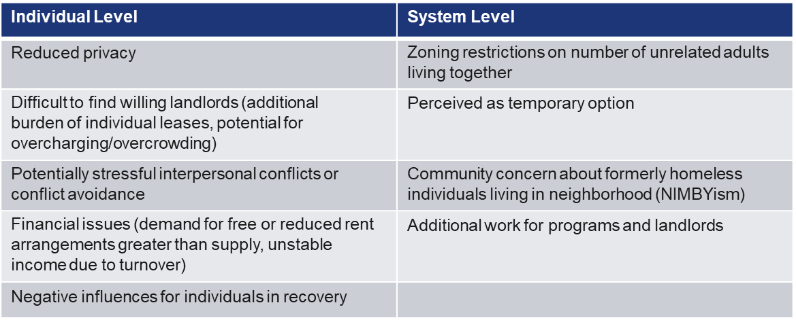
Challenges

Slide 17
Benefits
Community Benefits | Home seeker Benefits | Home owner Benefits
Adds new affordable housing without Section 8 vouchers | Lower rent payments for single adults | Older adults and home renters gain financial security by renting a room or renting a house
Reduces homelessness by housing multiple people at once | Less stress about money | Reduced vacancies due to continual presence of multiple tenants
Housing options made available in very high rent areas | Neighbors do not identify residents as formerly homeless | Matched home providers report feeling safer and less isolated
Existing housing stock is not vacant; raises home values | Peer support, connection and community opportunities | In college towns, landlords used to shared rentals
Maximize use of HUD housing assistance funds | First step to more independent living | Greater community engagement

Slide 18
Discussion

Slide 19
Resources
HUD COVID-19 Homeless System Response: Shared Housing- https://files.hudexchange.info/resources/documents/COVID-19-Homeless-System-Response-Shared- Housing.pdf
Shared Housing: A Toolkit for Supportive Services for Veterans Families (SSVF) and Housing and Urban Development-VA Supportive Housing (HUD-VASH) Programs- https://www.va.gov/HOMELESS/ssvf/docs/Shared_Housing_Toolkit_FINAL.pdf
Shared Housing Institute: https://www.sharedhousinginstitute.com/
-Check out “2021 Shared Housing Now! Conference” tab for a variety of in-depth webinars
National Alliance to End Homelessness (NAEH) Resources:
  Webinar: https://endhomelessness.org/resource/shared-housing-as-a-solution-for-single-adults/
  Blog: https://endhomelessness.org/blog/five-truths-about-shared-housing/

Slide 20

Keep in Touch with TAC!
Text TACINC to 22828
Sign up to receive our monthly newsletter, posts from our blog Access, and occasional updates on events and opportunities.
Follow us on Facebook and Twitter
@TACIncBoston
Housing and service strategies
that work for people

