Slide 1
State of Maine Navigators – Community of Practice
December 6, 2022

Slide 2
American rescue plan act
$4.6 billion impact to Maine
$1.5 billion for State and Local Fiscal Recovery Funds
$1 billion in discretionary State Fiscal Recovery Funds, which we call Maine Jobs & Recovery Plan
$500 million in Local Fiscal Recovery Funds to local governments across Maine
$3.1 billion earmarked by Federal government
Focus of today’s conversation
Notes:
Scott

Slide 3
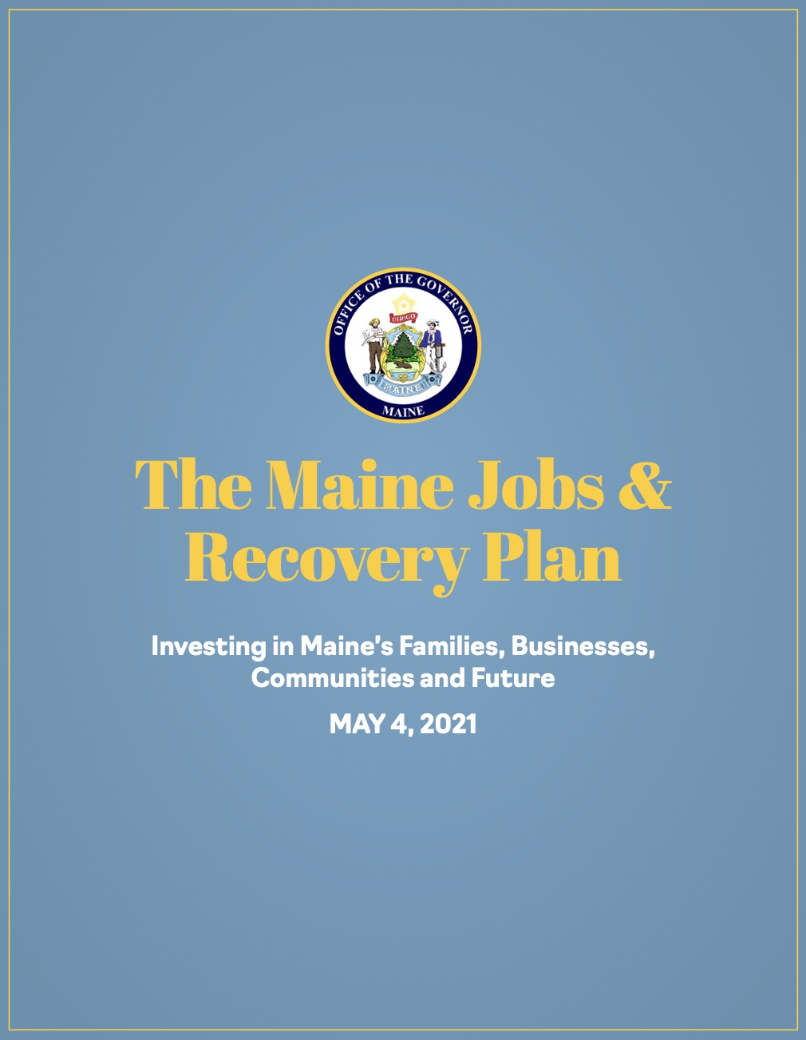
About the Maine Jobs & recovery plan
Governor Janet Mills’ plan to invest nearly $1 billion to help Maine people, businesses, and communities recover from the COVID-19 pandemic
Draws on recommendations from Governor’s Economic Recovery Committee and State’s 10-Year Economic Development Strategy to address systemic challenges that have constrained Maine’s ability to grow and thrive
Maine Jobs & Recovery Plan is receiving national recognition for allocation of funds towards economic recovery and worker training
Business Supports
Jobs & Career Programs
Investments in Maine People &
Communities
Notes:
Scott

Slide 4
Participating Programs
Maine Jobs & Recovery Plan: Maine.gov/jobsplan
Maine Department of Labor
Career Center Consultants- Outreach Workers
Healthcare Career Navigators
Apprenticeship Navigators
Peer Workforce Navigators
Maine Department of Education
Career Advancement and Navigation Specialists
College and Career Success Coordinators
Maine Department of Health and Human Services
Parents as Scholars
Higher Opportunity for Pathways to Employment (HOPE)
Maine Community College System
MJRP Workforce Development Navigators
Additional supports
Notes:
Erica

Slide 5
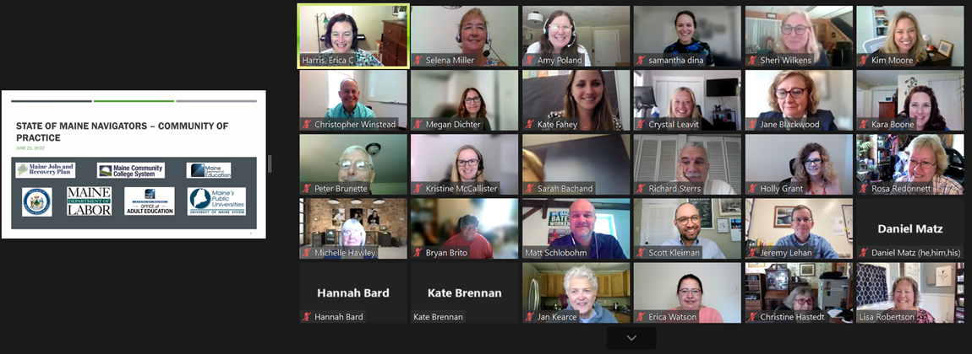
State of Maine Navigators – community of Practice Kickoff
Notes:
To date we have hosted 3 convenings of the CoP: June (for team leads and supervisors), September and November.
We’ve covered various topics, including an overview of all the programs, a deeper dive into coordination across programs/resources, and one focused on best practices related to outreach.

Slide 6
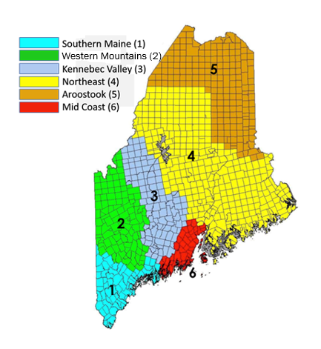
Future planning: Community of practice and you
December 13th meeting
An overview of Maine’s safety net: eligibility, access, and common issues
Will be recorded!
January 12th: joint convening with Maine Housing navigators
Shift to regional groups with quarterly convenings around topics that apply to all

Slide 7
CareerCenter Journey: Maine CareerCenter Services
Presented by the
Maine Department of Labor’s CareerCenters

Slide 8
Maine CareerCenters
Mission
Maine CareerCenters provide a variety of employment and training services at no charge for Maine workers and businesses. Whether you are looking to improve your job qualifications, explore a different profession, find a new career or hire an employee, the Maine CareerCenters can help.
Notes:
Give a brief overview of the Mission
Note: We use the words, “at no charge” vs. FREE – all services are provided through grant funding and in turn they are of no charge to job seekers and employers.

Slide 9
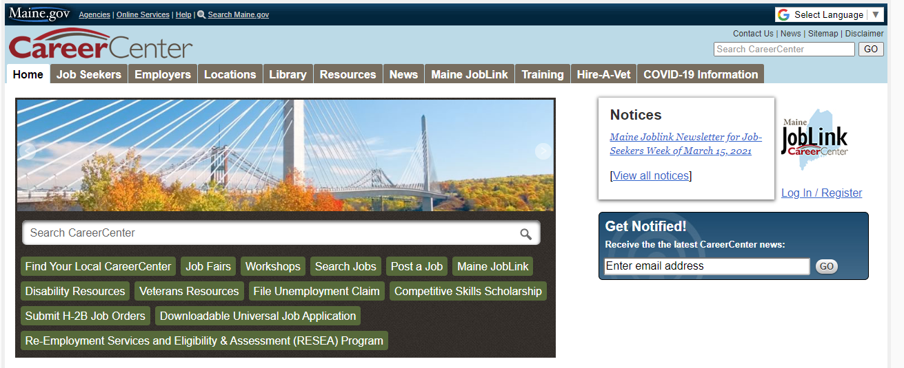
Maine CareerCenter Website
Notes:
Offers links to a variety resources for job seekers and employers
Information and registration for workshops and job fairs, research training information, labor market information, library of job seekers and employers catalogs.
Access the MCC Live Chat portal where you can aske questions and receive answers in real time.

Slide 10
Our Locations
There are 12 CareerCenters in Maine
Augusta
Bangor
Brunswick
Calais
Hinckley
Lewiston
Machias
Portland
Presque Isle
Rockland
Springvale
Wilton
CareerCenter Resources are provided at no charge for all Jobseekers and Employers!
Services Available
Monday – Friday
Virtual Services
In-person appointments
207-623-7981
Notes:
Yes – we are open for business! Call us to schedule an appointment.
When you make an appointment your assureg that you will have our utmost attention to assist you with your job search. It all allows us to meet you where you are in the process.

Slide 11
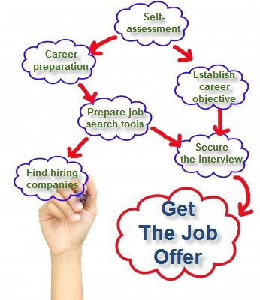
Resources at the CareerCenters
CareerCenter Consultants
Job Searching Basics
Maine JobLink
My Skills My Future
My Next Move
O*Net Online
Workshops
Hiring Events
Notes:
Some of our resources include:
Assistance with creating and navigating your MJL account
Not sure what you want to do for work? No problem… we will provide you with occupational assessments and help you interpret the results.
Assistance with resume development
Assistance with writing cover letters
Preparing for interviews
Make referrals to partner resources
Linkage to special programs – bonding and WOTC to give you an edge for hiring

Slide 12
Getting Started with Your Journey
Our staff are available to help you navigate your job search and offer support when you really need it.
We offer:
Fully qualified, expert assistance
Up-to-date resources
Knowledge of companies and industries hiring
Specialized staff are available to assist with certain program questions
Notes:
Talk about staff qualifications
We offer a diverse pool of consultants who provide resources to a broad customer base. There is a combined wealth of knowledge and experiences – in some cases – more that 50-60 years – just waiting to assist you with your job search.

Slide 13
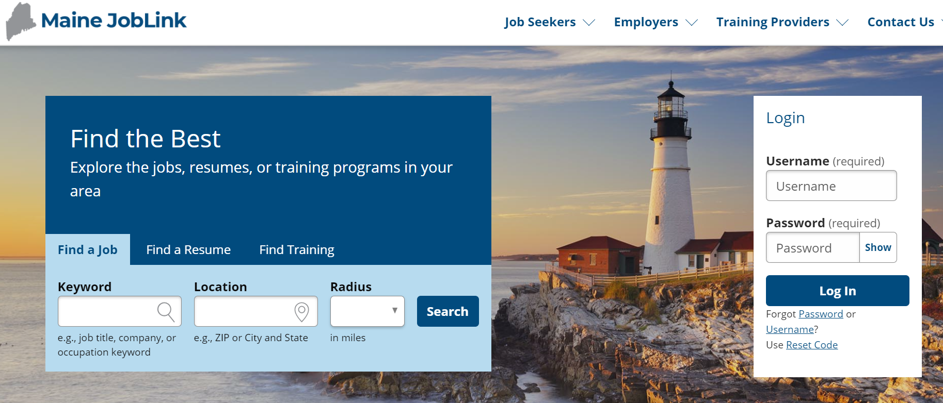
Maine JobLink
https://joblink.maine.gov/
Notes:
Job matching system of listed jobs to resumes and information of job seekers
No charge for employers and job seekers
Job seekers complete a profile and add a resume – try the resume creator – system will notify you by email of new job matches
All job posting must meet certain criteria before being posted

Slide 14
Workshop Opportunities
Sample of Virtual Workshops on our Website: Provided by MDOL and Partners
Creating and Navigating Your Maine JobLink Account
Creating a Winning Resume
Preparing for your Virtual Interview
Create and Promote Your Linkedln Account
Support for Unemployed Workers Affected by Opioid Crisis
Zoom Basics & Job Search Essentials
http://www.mainecareercenter.gov/index.shtml
Notes:
Workshops are appx. 60-90 minutes and are offered virtually through MS Teams and Zoom or in some cases, in person.
You may register under the workshop tab on the Maine CareerCenter website

Slide 15
Hiring Events
Hiring Events on our Website:
Drive-Thru Hiring Events
Maine CareerCenters Virtual Hiring Event
Hiring Event for Specific Employers
http://www.mainecareercenter.gov/index.shtml
Notes:
There are a variety of training opporutnities offered by the CC and our partners.
Suggestion: Treat each event as if it were an interview
We promote hiring events on our social media outlets
You may want to subscribe to our facebook page

Slide 16
Education and Training Opportunities
Bureau of Employment Service
Competitive Skills Scholarship Program
Apprenticeship Program
Veteran Services –JVSG
Bureau of Rehabilitation Service
Vocational Rehabilitation
Division of Blind and Visually Impaired
Division for the Deaf, Hard of Hearing, and Late Deafened
Adult Education
Workforce Innovation Opportunity Act (WIOA)
Eastern Maine Development Corporation
Aroostook County Action Program
Workforce Solutions
Notes:
There are a variety of training opportunities offered by the CC and our partners

Slide 17
Competitive Skills Scholarship Program
A scholarship
Training for High Wage in Demand Occupations
Can support a certificate, associate’s or bachelor’s degree
Can support OJT (on the job training)
Can support apprenticeship
Will pay tuition, fees, books and some support services
Notes:
There is an application process that we can assist you with… once you submit your application, a case manager will reach out and discuss eligibility requirements and answer your questions.
Allows up to $6000 per year for those who qualify.
Travel, stipend, some childcare for school

Slide 18
Maine Apprenticeship Program
High Wage and In-demand Jobs
Includes On-the-Job Learning and Related Training Instruction
Earn while you Learn approach
Apprentices gain marketable skills
Nationally recognized certification
On-the-Job Learning is a minimum of 2000 hours (one year program) and a maximum of 10,000 hours (five years)
Related Training Instruction is a minimum of 144 hours per year
Notes:
This is a great alternative to attending college as you earn while you learn. In some cases, the employer will sponsor the majority of your training. There are also opportunities, if you qualify, for tapping into other training funding, to help with the cost of training.
Start wages for the occupations are predetermined and increase as you build your skills and knowledge up to the journey worker wage.
Most employers who sponsor apprenticeship programming may be found on Maine JobLink.

Slide 19
Veteran Services
Veterans or transitioning service members can meet with a Veterans' Representative located around the state who are ready to serve you.
Veteran Priority of Service
Veteran Priority of Service means, with respect to any qualified Department of Labor employment and job-training programs, that Veterans and Eligible Spouses shall be given priority over non-Veterans for the receipt of employment, training, and placement services, notwithstanding any other provision of the law.
Notes:
CCs give all veterans a priority of service and those who meet specific criteria are also eligible for individual outreach services and benefits.

Slide 20
Vocational Rehabilitation Services
The Division of Vocational Rehabilitation, also known as “VR”, is a Department of Labor Program that helps people who have disabilities to find and keep a job. VR helps people who have physical, mental or emotional disabilities.
Notes:
Intensive assistance for job seekers who qualify. Also, may provide funding for adaptive equipment, schooling, job coaching, job placement, work experience opportunities. CCC can put you in touch with the counselor of the day to answer your questions.

Slide 21
Division for the Blind and Visually Impaired
If you have a vision problem that prevents you from carrying out the activities of daily living, getting an education or a job, there is help. The Division for the Blind and Visually Impaired can provide many services to persons with severe visual impairments.
Notes:
Additional services, adaptive equipment, WEX,
CareerCenters have adaptive communication equipment that may be used during your visit.

Slide 22
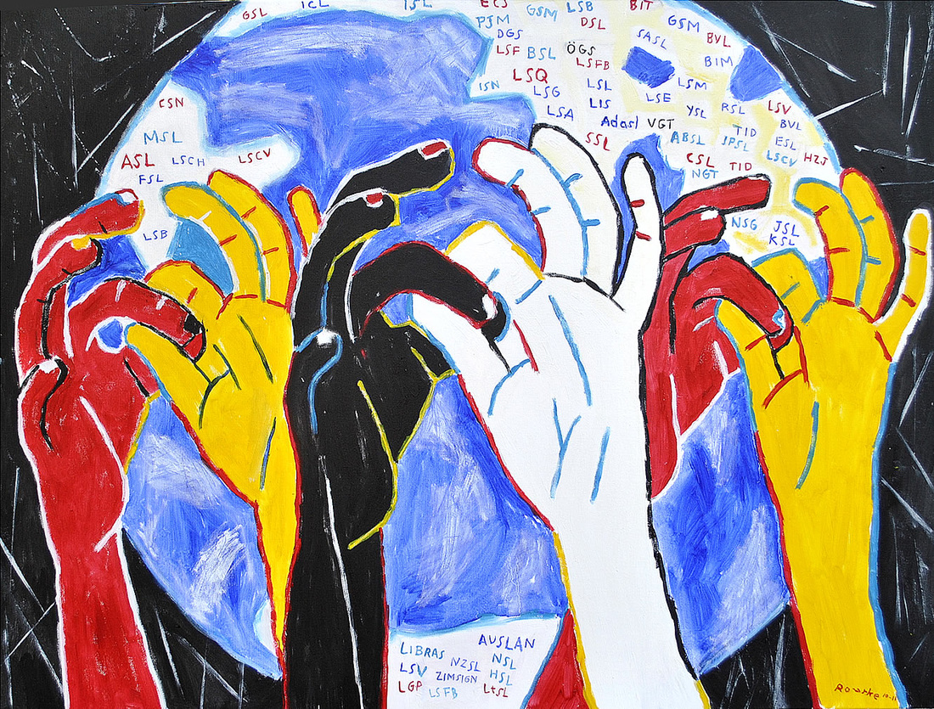
Division for the Deaf, Hard of Hearing, & Late Deafened
Services of this division include deaf identification cards, vehicle placards, TTY discount, listing of legal interpreters, and other resources.
Vocational Services are provided to individuals in need through general Vocational Rehabilitation programs.
Notes:
WEX

Slide 23
Maine Adult Education
Our Mission:
Maine Adult Education Association is a professional, non-profit organization that advocates for adult education locally, statewide and nationally and supports members in order to meet the educational, training and personal needs of Maine’s adults.
https://maineadulted.org/
Notes:
State-wide partners, some of our workshops are provided by the AEDs.
We partner with AEDs to provide certificate programs such as C.N.A., CDL training, Hi-SET/GED

Slide 24
Job Corps
Penobscot Job Corps Center
At Penobscot Job Corps Center, we support the Job Corps program’s mission to teach eligible young people the skills they need to become employable and independent and place them in meaningful jobs or further education.
https://penobscot.jobcorps.gov/
Loring Job Corps Center
At Loring Job Corps Center, we support the Job Corps program’s mission to teach eligible young people the skills they need to become employable and independent and place them in meaningful jobs or further education.
https://loring.jobcorps.gov/
Notes:
Partner – Youth vocational programming for those who qualify
They offer several job training programs in the trades, healthcare, food industry
Students live on campus while attending school and may work towards earning their high school credentials and driving licenses.

Slide 25
Senior Community Service Employment Program
The SCSEP is a transitional training program designed to prepare older adults, who have a training need and barriers to employment, for steppingstone jobs.
The Senior Community Service Employment Program (SCSEP) is a grant administered by the United States Department of Labor that provides work-training opportunities for low-income persons aged 55 or older.
Notes:
55+ program for those qualifying financially. Work training opportunities in a variety of occupations
Offers WEX, training programs – earn while learning new career skills. Also known as A4TD in Maine

Slide 26
Personalizing Your Connection to Resources
Let us use our knowledge of local and statewide resources to connect you with the best programs, services, and support to fit your needs and goals.
Notes:
CCCs make a wide variety of referrals to resources, employers, and in general are knowledgeable of local and state wide offerings.

Slide 27
Workforce Innovation Opportunity Act - WIOA
Designed to help job seekers access employment, education, training, and support services to succeed in the labor market and to match employers with the skilled workers they need to compete in the global economy.
Notes:
Administered by our Title 1B partners – offers a variety of employment, education, and training opportunities.
Financial resources for training for those who qualify
WEX programming
CCs make referrals to their programs on your behalf

Slide 28
Eastern Maine Development Corporation
HOW CAN WE HELP YOU?
People Pursuing Education/Careers
Businesses Investing In Workforce
People Who Have Been Impacted By Opioid Use Disorder
People Who Are Transitioning From Correctional Facilities
Migrant And Seasonal Farm Workers & Families
Careers In Information Technology
https://www.emdc.org/
Notes:
Central/Western Maine
Special grant programs – COVID, WIOA, Opioid
Provides workshops and specialized programs for targeted populations
Offered virtual office hours

Slide 29
Workforce Solutions
Workforce Solutions staff works with individuals
Adult Employment Services
Youth Employment Services
Business Services
https://workforcesolutionsme.org/
Notes:
Coastal counties
Grants – COVID, OPIOID, WIOA
Workshops

Slide 30
Aroostook County Action Program
Aroostook County Action Program, Inc. provides services and resources that help individuals and families achieve greater economic independence. As a leader, or in partnership with others, ACAP strengthens the community by responding to human needs.
https://acap-me.org/

Slide 31
Tuition Assistance Resource https://meoc.maine.edu
Maine Educational Opportunity Center (MEOC)
A Maine federally funded program that works with adults in traditionally underserved populations to assist them in going on to college.
Provides information and assistance in completing college admission and financial aid forms
Assists with assessing academic readiness
Provides career counseling
Makes referrals to community resources
Notes:
Assists with locating educational funding resources,
Offers assistance through peer navigators.

Slide 32
Need Additional Assistance with Your Job Search?
CareerCenter Consultant of the Day
MaineDOL.CareerCenter@maine.gov
CareerCenter Central Hotline
1-207-623-7981 Monday through Friday 8:00am – 5:00pm
TTY users call Maine Relay at 711
Maine CareerCenter Live Chat
www.MaineCareerCenter.gov
Monday through Friday, 8:00am – 4:00pm
Notes:
Need assistance with your job search and career decisions? We can help.
The Maine CareerCenters has a variety of ways to help you with your job search. Our consultants are standing by for you to reach out with your questions.

Slide 33
THANK YOU!

